Slide 1


Slide 2
It’s time to unlock the full power of the British Council.

Slide 3

Let’s start

Slide 4
The British Council is an infinite source of events, content, classes and certificates

Slide 5
We cover a big part of the world through our physical and online presence

Slide 6
Still, many people don’t know us

Slide 7
And the ones that do, just know a small part of our work

Slide 8
We try to raise our awareness, but we have too many online portals and websites were people get lost

Slide 9
In the meantime, our business is suffering because competition is moving fast

Slide 10
The whole organisation needs to focus its efforts on being easy to understand and engage with.

Slide 11
What can we do to make the activities of the entire operation more visible?

Slide 12

Put them in THE CALENDAR

Slide 13
The Calendar is where every SBU from every country…

Slide 14
…will put their events, online classes, F2F classes and exams

Slide 15
The calendar would have smart and easy filters to display the different elements and content

Slide 16

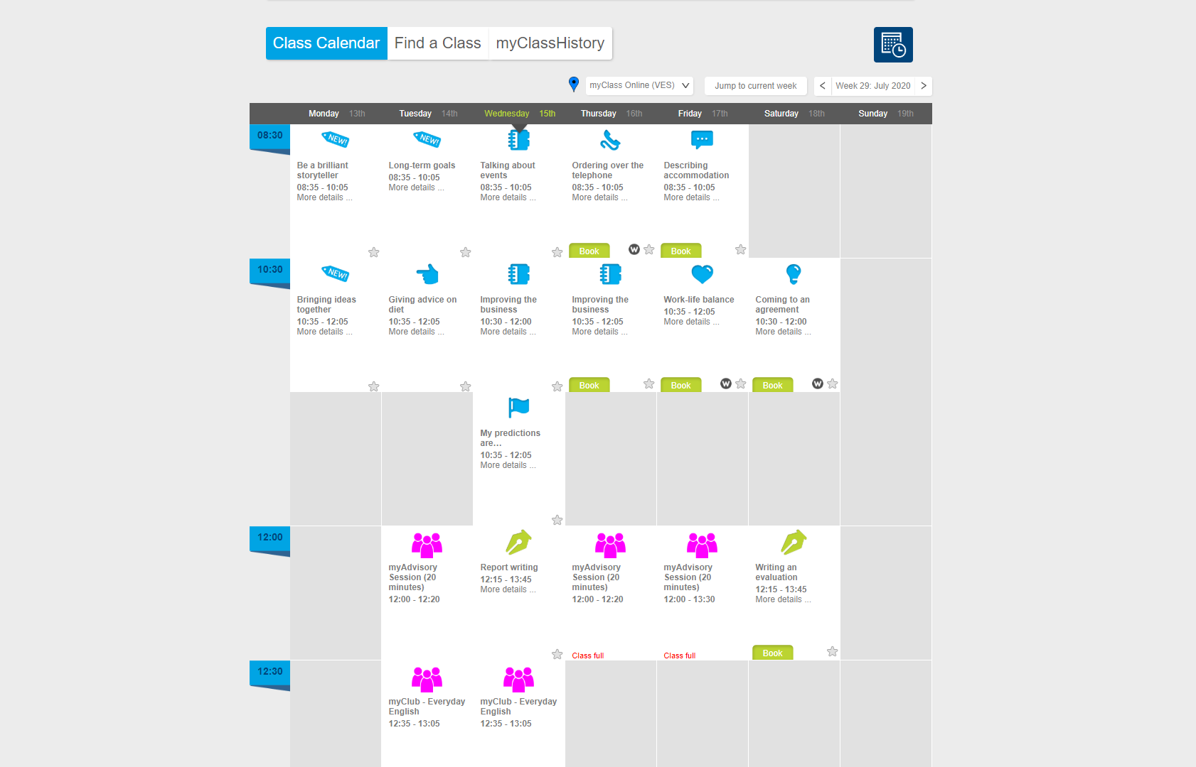
Region
Children
Adults
Month view
Week view
English & Exams sessions
Easy-to-use filters to find information
Webinars
Cultural events

Slide 17
There would be 2 layers of content

Slide 18
1- Free content accessible in exchange for visitor’s contact details

Slide 19
2- Paid content and subscriptions both online and F2F, exams…

Slide 20
Around the calendar, we would build landing pages to make it visible from paid and non-paid channels

Slide 21
We’ll have Hubspot to nurture our databases and put people in the conversion funnel

Slide 22
We will segment audiences and profiles to improve marketing effectiveness and lower the cost per acquisition

Slide 23
We’ll also have great knowledge of English levels and learning preferences in each country

Slide 24
AI

Slide 25
AI will play a major role for both learners and us.

Slide 26
Learners will benefit from AI chat, level checks,

Slide 27
and personalised course recommendations.

Slide 28
On our side, AI can use the data for upselling and cross-selling,

Slide 29
as well as for revenue prediction and forecasting.

Slide 30
Numbers

Slide 31
According to Ambition 2030, we aim to reach 1 billion people.

Slide 32
If 20% of them use are driven to the Calendar, that’s 200 million people.

Slide 33
If 30% of that group sign up for the free layer, we’ll build a database of 60 million people.

Slide 34
If 10% of that database spend £100, that generates £600 million in income.

Slide 35
So it’s a good way to recover and grow, and a tool to strengthen our position against competitors.

Slide 36
USP: The only global, AI-powered gateway to English learning, exams, and cultural opportunities.

